Slide 1
SCIENTIFIC COMPUTING
Comparison of Jacobi and Gauss-Seidel Iterative Methods for the Solution of Systems of Linear Equations
A. I. Bakari and I. A. Dahiru
Department of Mathematics, Federal University, Dutse, Nigeria
Linear Systems • Convergence Analysis

Slide 2
JACOBI VS SEIDEL ITERATIONS
Core Loop & Differences
Jacobi Method
Gauss-Seidel Method
Calculations depend strictly on previous iteration values.
In-place substitution immediately uses newly computed unknowns.
sum += A[i][j] * x_old[j];
x_new[i] = (d[i] - sum) / A[i][i];
// buffer swap after full pass
x_old = x_new;
sum += A[i][j] * x_curr[j];
x_curr[i] = (d[i] - sum) / A[i][i];
// immediately available for row i+1

Slide 3
TEST CASES
System Inputs and Computed Solutions
Test Case 2
Test Case 3
Test Case 0
Test Case 1
5×5 System
3×3 System
4×4 System
2×2 System
Order: n = 5
Order: n = 3
Order: n = 4
Order: n = 2
x1 = 1.000
x2 = 1.000
x3 = 1.000
x4 = 1.000
x5 = 1.000
x1 = 1.000
x2 = 2.000
x3 = -1.000
x1 = 1.000
x2 = 1.000
x3 = 1.000
x4 = 1.000
x1 = 1.000
x2 = 1.000

Slide 4
EVALUATION
Iteration Counts and Error Percentages
Tolerance threshold = 0.0001 (1e-4)
Test Suite | Order (n) | Jacobi Iterations | Jacobi Error % | Seidel Iterations | Seidel Error %
Test Case 0 | n = 3 | 8 | 0.000950% | 4 | 0.000750%
Test Case 1 | n = 2 | 8 | 0.004800% | 5 | 0.000700%
Test Case 2 | n = 4 | 11 | 0.001500% | 5 | 0.000150%
Test Case 3 | n = 5 | 12 | 0.001700% | 5 | 0.000720%

Slide 5
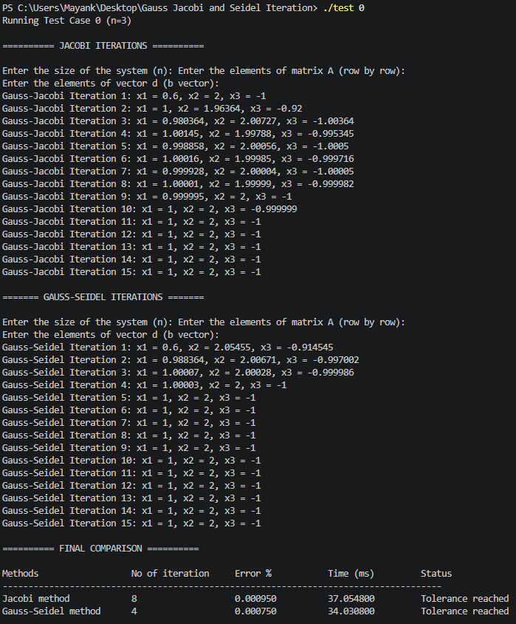
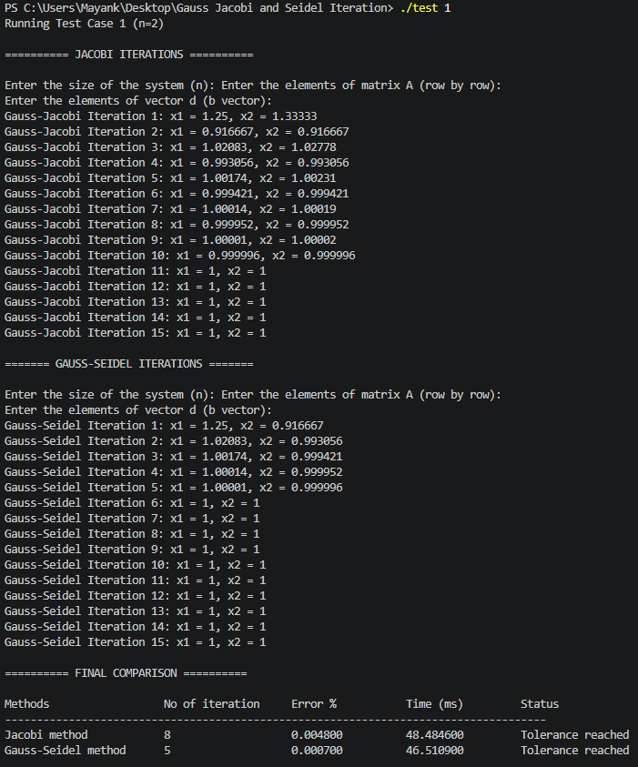

Slide 6
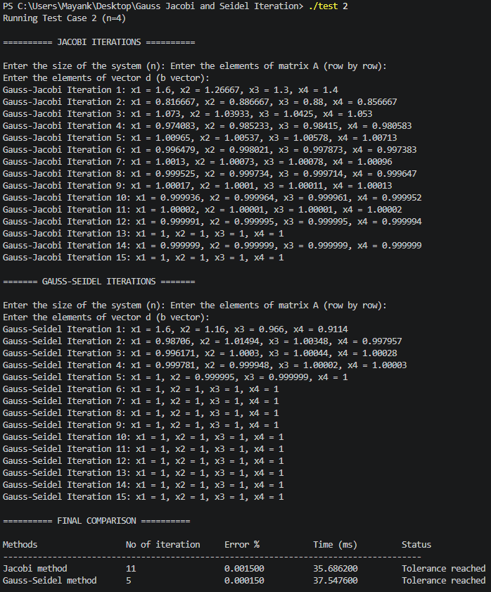
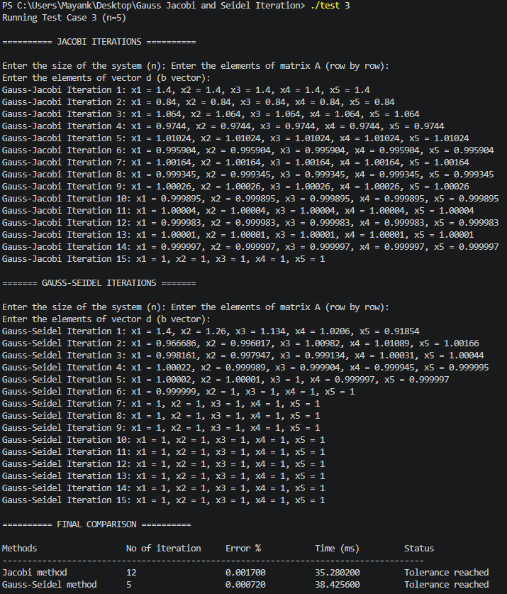

Slide 7
CONCLUSION
Why Gauss-Seidel Converges Twice As Fast
Immediate Variable Updating
About 2x
Newly computed components are immediately used in subsequent equations during the same iteration,
allowing updated values to propagate faster and reducing the number of iterations required to achieve convergence compared to Jacobi.
Convergence
Gauss-Seidel reaches identical tolerance in roughly half the iteration count across all systems.

